Slide 1
Woodland Public Schools
Facilities and Safety Report
For November 2019

Slide 2
FACILITIES REPORT
Urgent Repair Grant Program We applied for 2 projects under the Urgent Repair Grant Program from OSPI and received notification last week that WSD was being awarded grant money. The two projects requested were new gutters and downspouts for the Middle School complex. The second project was to replace the water main from Park Street to the Green Gym. At this point, I don’t know if one or both projects have been approved. Fingers are crossed.
Year End Break In parallel with our normal deep clean during the holiday period, our department will be completing multiple required annual inspections, tests and compliance reports. These include annual air emissions reports, stack testing for boilers at 3 schools, domestic water backflow testing, grease trap inspections and a few other PM and mandatory test and inspections.
Reunification Drill March 2020 Work continues on the reunification drill scheduled for March. Met with the Police Chief and the Director of Emergency Management for Cowlitz County last week. During this meeting, we went over the drill overview and discussed how to engage all first responders during the drill. I am also working on two other key elements of the plan. Identification of the reunification team members, and secondly, the development of an emergency busing plan.

Slide 3
FACILITIES REPORT
Yale School Fencing Completed the installation of approximately 500 feet of fencing at the Yale School. This fully encloses the school’s sports field, protecting students from unwanted visitors (primarily cows and deer).
Automated Lockdown Announcement – Work continues on this project, additional electrical hardware equipment needs to be ordered to complete the testing. Once received, we will “pilot” the program at one of the schools; then, deploy to the balance.

Slide 4
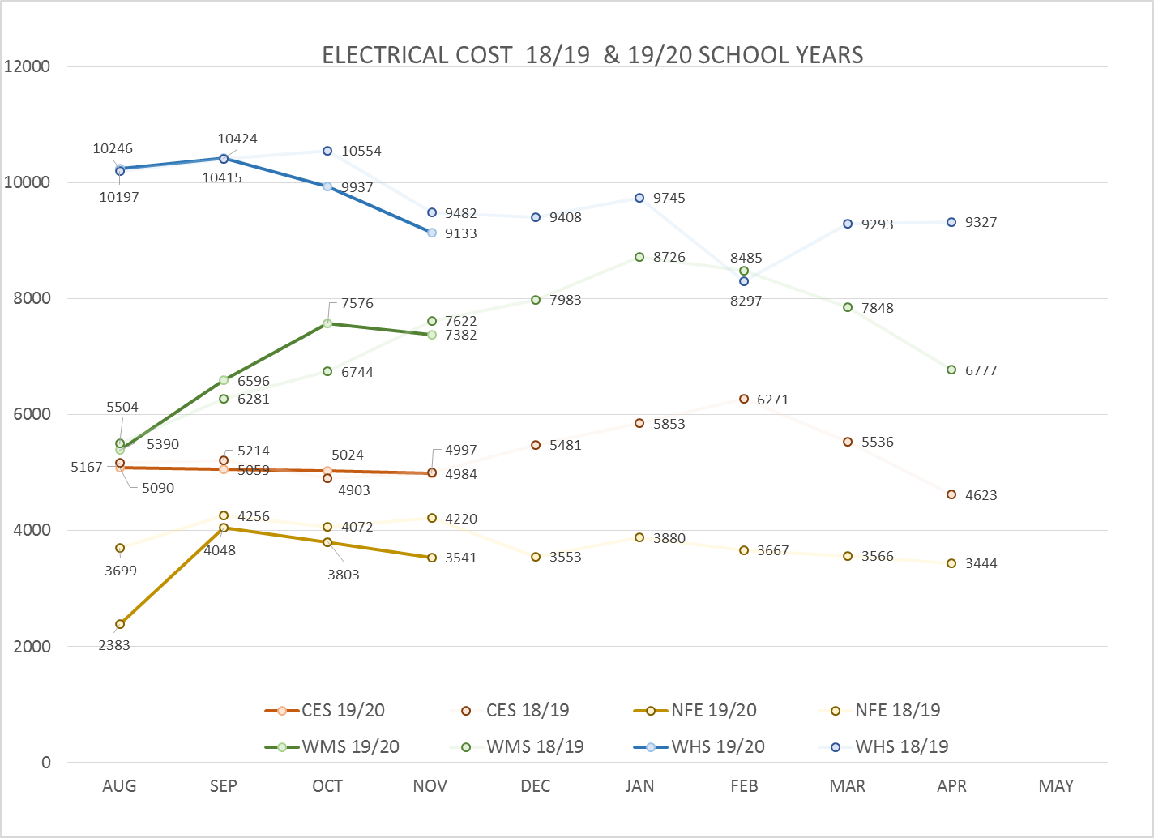
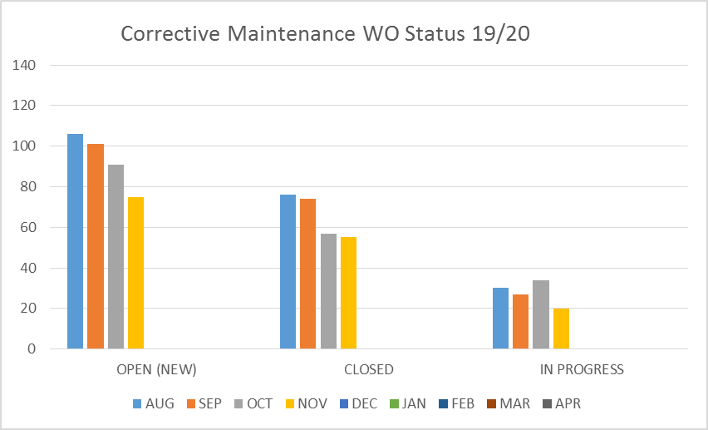
FACILITY CHARTS – POWER COST AND WORK ORDER STATUS

Slide 5
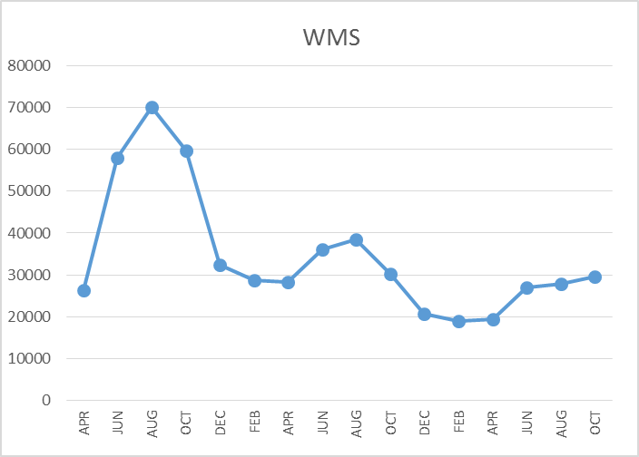
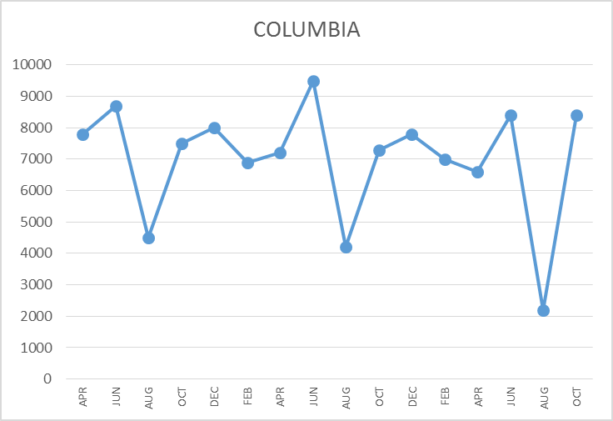
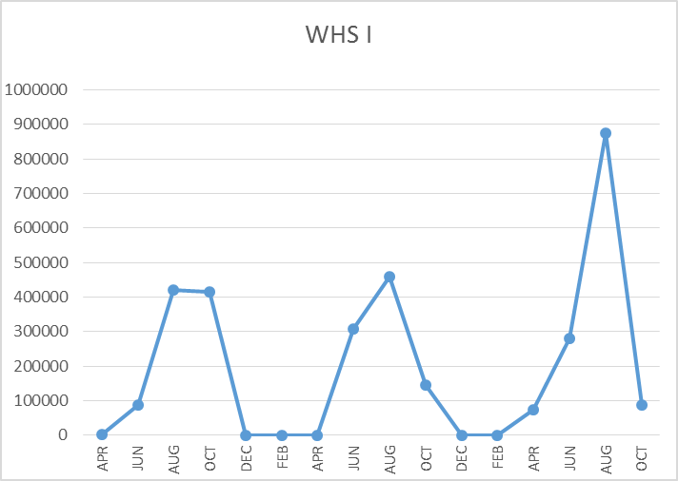
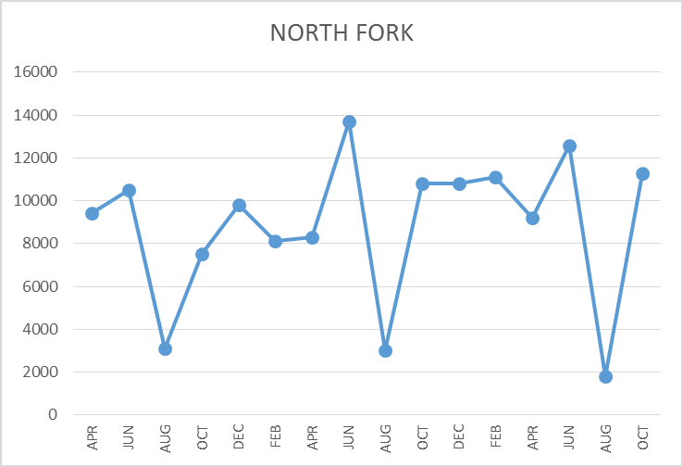
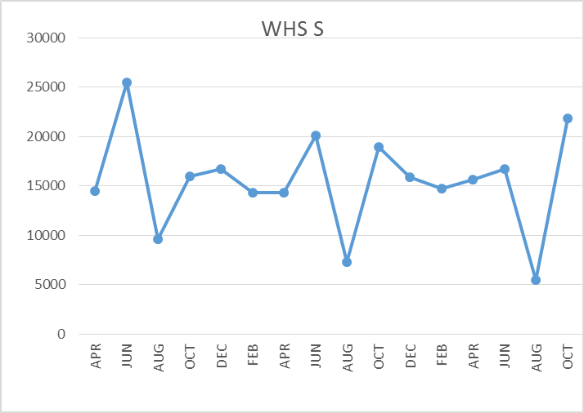
FACILITY CHARTS – WATER USAGE WHS, NFE, WMS, CES
Note
Water charts are updated every two
months. Next update to these charts
in January 2020
LEAK
REPAIRED
The WMS chart has been reconfigured to include the following 7 meters: 755 Park high and low flow, BO and Team High, PIT house, bus barn, athletic field and DO. All of these meters are totaled on the WMS graph, but each data point is recorded separately to aid in identifying leaks.

Slide 6
SAFETY SUMMARY
Staff Accidents/Incidents (1)
WMS- Employee was hit by ball in the jaw while supervising PE- Laceration and contusion
Student Accidents/Injuries (6)
WMS-Cut head while retrieving ball under bleachers
WMS-Playing basketball students collided one fell- contusion to elbow
WMS-Student broke tibia while performing wrestling drills
WMS-Student slipped and hit head on electrical transformer- neuro checks completed
WHS-Dropped bulk metal on foot- broke and lacerated toe
WHS-Soccer player tangled with another, fell on knee contusion

Slide 7
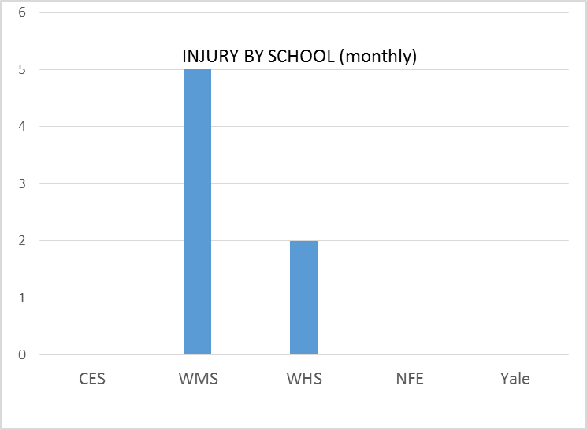
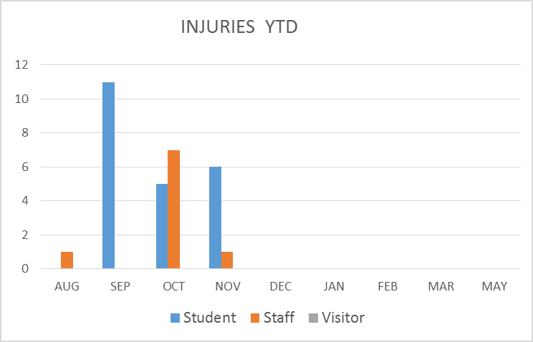
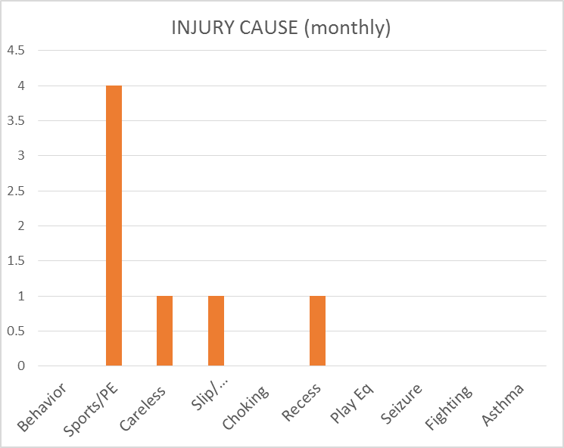
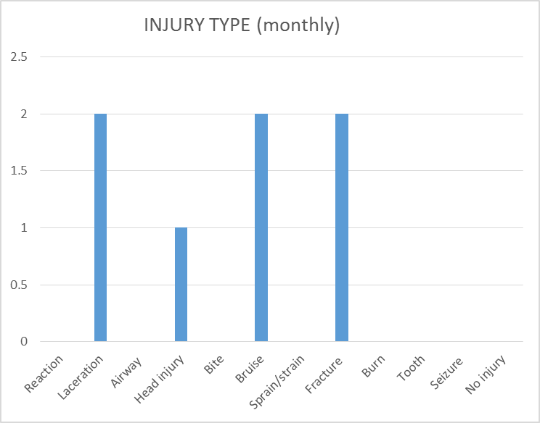
SAFETY CHARTS

